Slide 1

Pairs Trading Strategy
Joaquín Uriel Ramírez Pérez

Slide 2


Project Overview
Objective:
• Design and backtest a Pairs Trading Strategy
• Use Cointegration to detect long-term economic relationship
• Use VECM to generate trading signals
• Use Kalman Filter to estimate dynamic hedge ratio
Assets: CVX & VLO
Time Period: Last 10 Years

Slide 3

Data Collection
• Data sourced from Yahoo Finance
• Used Opening Prices
• Log-prices used for cointegration analysis

Slide 4
Cointegration Analysis
• ADF Test: Check Stationarity (p_value > 0.05)
CVX = 0.63
VLO = 0.66
• Engle-Granger Test: Check Cointegration (p value < 0.05)
Cointegration = 0.043
• Johansen Test: Confirm Cointegration Rank
Eigenvalues = [0.00519923 0.00066234]
Eigenvectors = [[ 0.0865 0.0112] [-0.0811 0.0184]]
Result: CVX & VLO are cointegrated

Slide 5
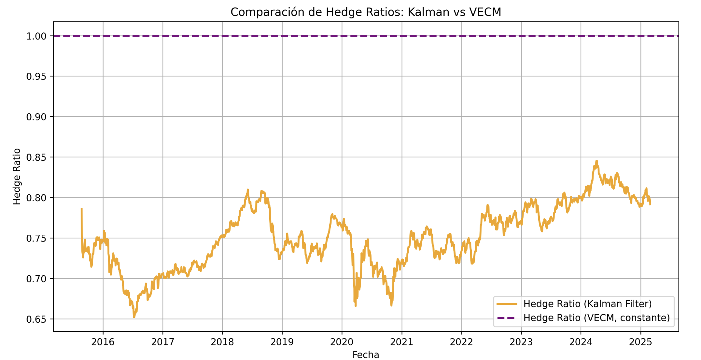
Hedge Ratio Estimation
• OLS Regression for static hedge ratio
Intercepto (α): -22.4308
Coeficiente (β - Hedge Ratio): 0.9851
R²: 0.8814
• Custom Kalman Filter for dynamic hedge ratio
• Compared Kalman and VECM hedge ratios

Slide 6
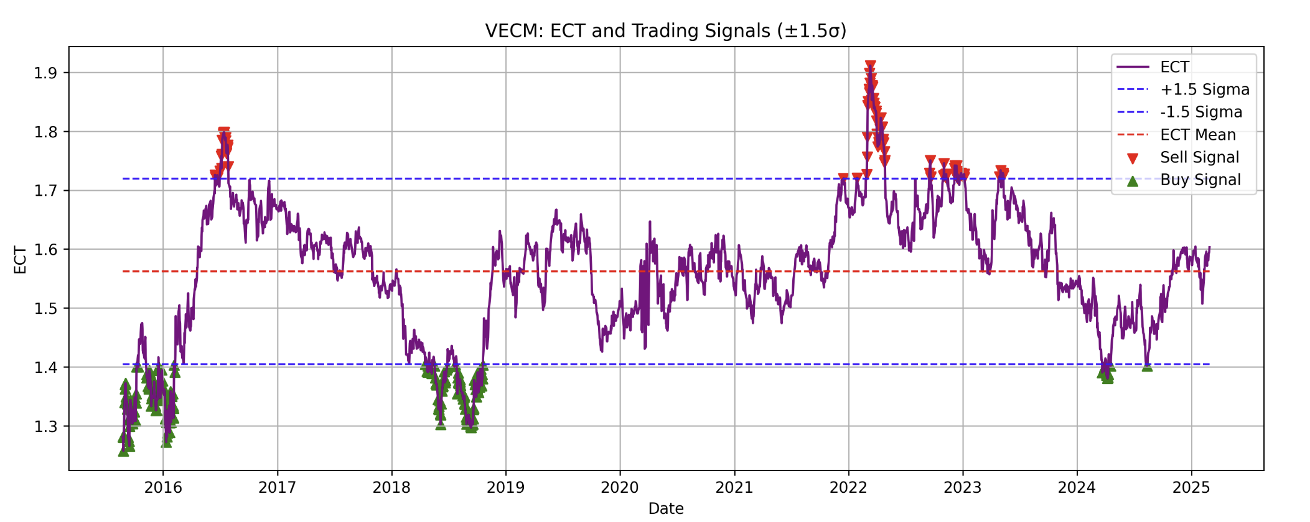
Trading Signal Generation
• VECM used to compute Error Correction Term (ECT)
• Entry/Exit thresholds set at ±1.5σ
• Trading Signals:
- Short CVX / Long VLO if ECT > +1.5σ
- Long CVX / Short VLO if ECT < -1.5σ

Slide 7

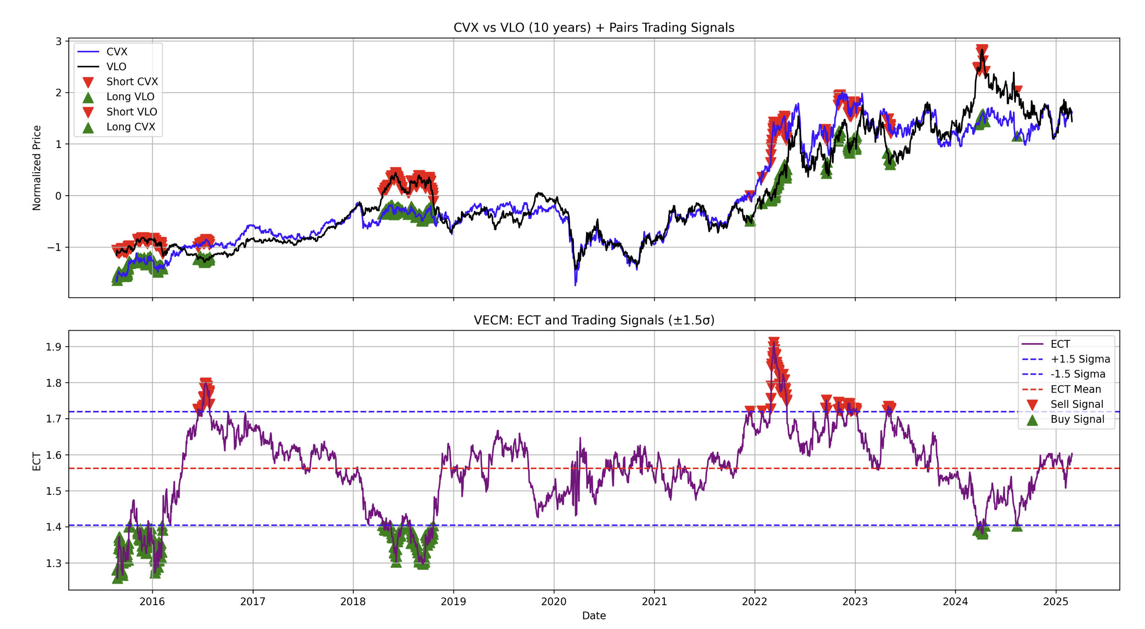




Slide 8
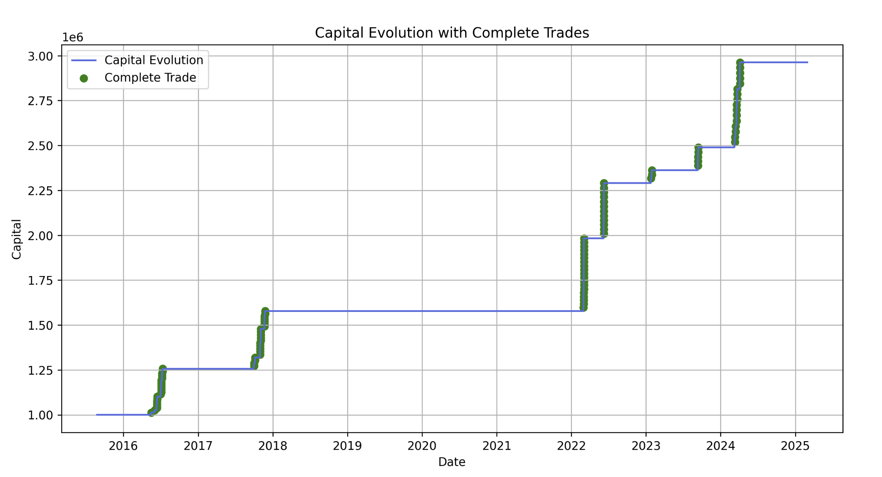
Backtest Strategy
• Initial Capital: $1,000,000 USD
• Transaction Cost: 0.125% per trade
• Each trade uses 5% of available capital
• Trades closed at +25% profit target
• Multi-position allowed (several trades open simultaneously)
Date 01-03-2025 Portafolio Value $2,962,904 USD

Slide 9
Performance Metrics
• Total Number of Tardes = 96
• Winning Trade Percentage = 100%
• Maximum Drawdown = 0
• Equity Curve with trade closures marked

Slide 10
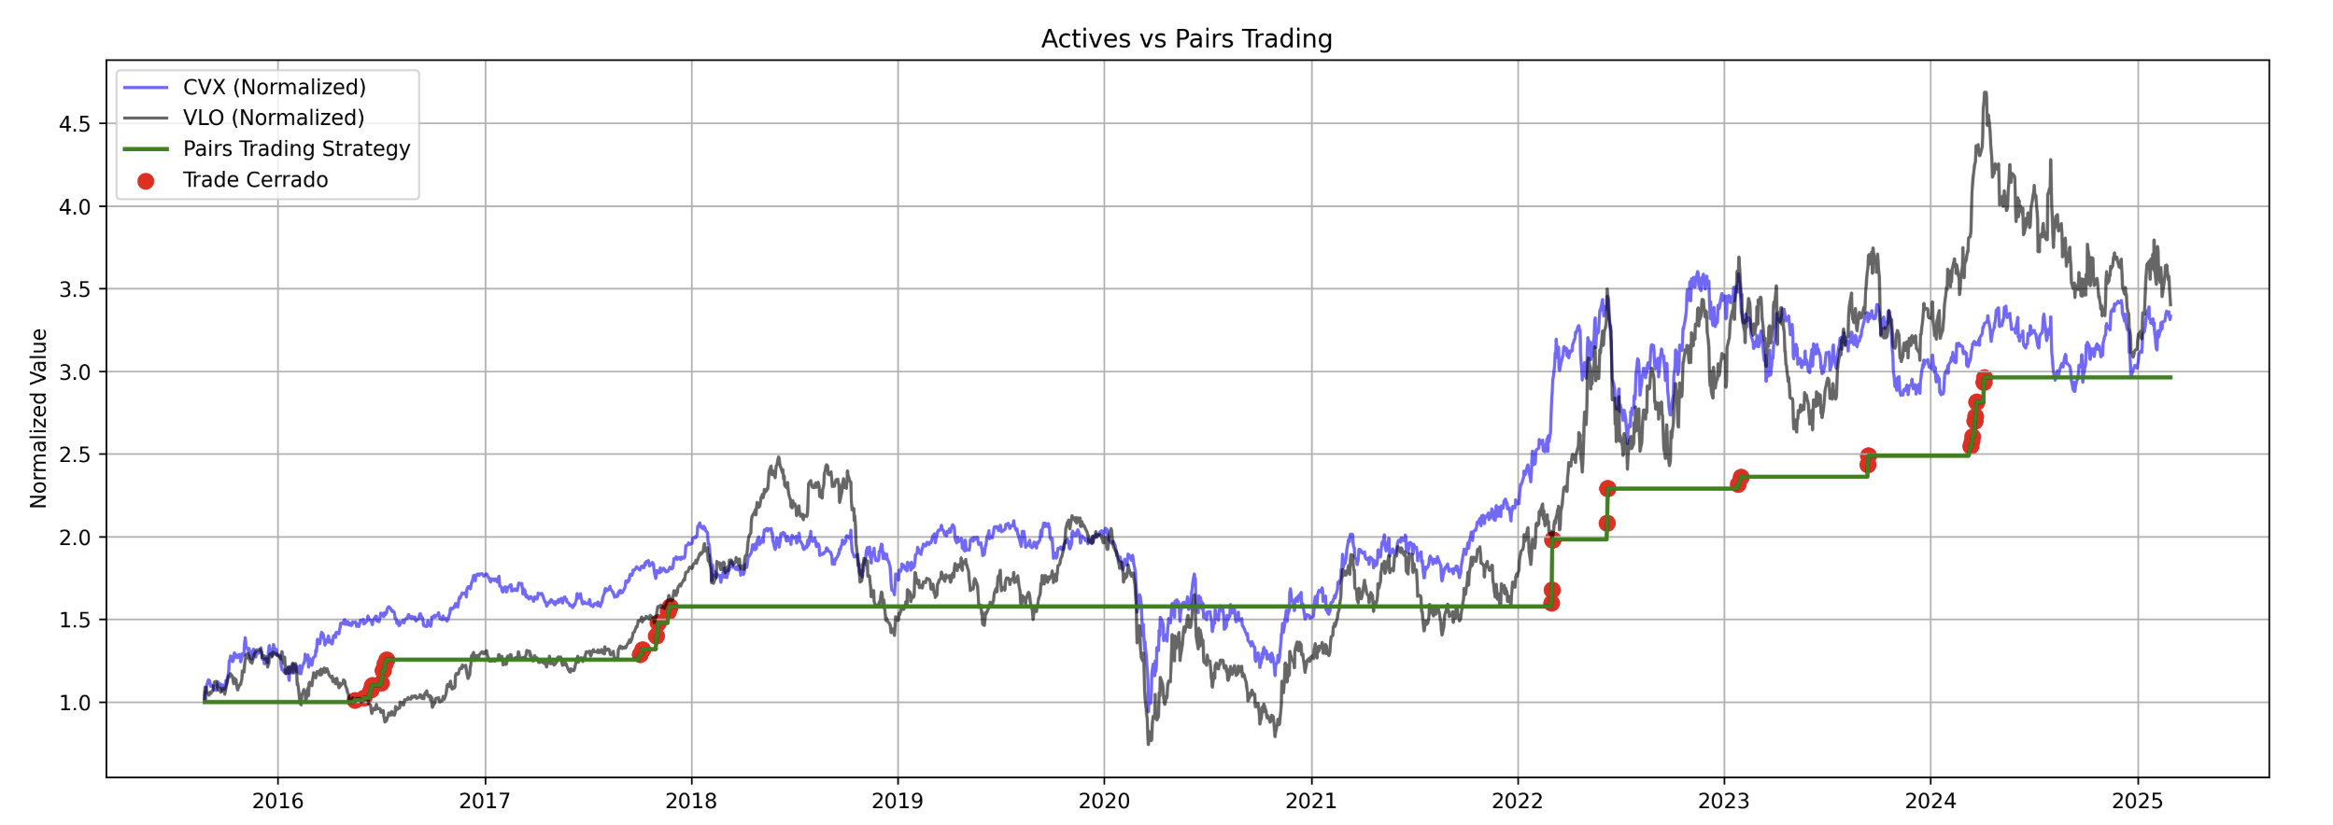
Key Visualizations
• Normalized Price Chart with Trading Signals
• Equity Curve with Closed Trades

Slide 11
Results & Conclusions
• In this case with this Pairs Trading Strategy we never find losses (see in the Backtesting Strategy Slide)
We find 2293 trade signals and we only use 96, because sometime we dind´t have the capital to operate
Time = 10 years
Initial Capital = $ 1,000,000 USD
Minimum Portfolio Value during 10 years = $ 1,000,000 USD
Final Portfolio = $ 2,962,904 USD

